Slide 1




HOSPITAL
MANAGEMENT SYSTEM
Hospitals play a crucial role in providing the best medical care to people suffering from various ailments, changing climate conditions, increased workload, stress, and more.

Slide 2

Content
01
02
03
04
IDEA
AIM
DIAGRAM
ETL
05
06
Data Analysis Using POWER BI
ML MODEL

Slide 3



IDEA
This project is a hospital management system aimed at improving medical care by addressing several key challenges:
- Managing large volumes of hospital operations and records manually.
- Doctors being unable to supervise all cases due to the high number of patients.
- Financial constraints in some hospitals, leading to outdated medical equipment and insufficient staff.
In addition, the project incorporates AI for brain tumor classification using Convolutional Neural Networks (CNNs). The goal is to accurately classify MRI images of brain tumors into four categories:
- No Tumor , Pituitary Tumor , Meningioma , Glioblastoma.
01

Slide 4


AIM
01
02
03
EFFECTIVE MANAGEMENT OF MEDICAL RECORDS
IMPROVE PATIENT EXPERIENCE
EFFICIENT RESOURCE MANAGEMENT
- SAVE AND ORGANIZE PATIENT RECORDS ELECTRONICALLY FOR EASY ACCESS BY DOCTORS AND NURSES, WHICH CONTRIBUTES TO SPEEDING UP DIAGNOSIS AND TREATMENT AND AVOIDING DATA LOSS.
- PROVIDING A FLEXIBLE AND AVAILABLE APPOINTMENT SYSTEM, REDUCING WAITING PERIODS, INCREASING CONVENIENCE IN RECEIVING HEALTH SERVICES, WHICH POSITIVELY REFLECTS ON THE PATIENT EXPERIENCE IN GENERAL.
- MONITOR AND MANAGE MEDICAL INVENTORY (SUCH AS MEDICINES AND MEDICAL SUPPLIES) ACCURATELY, TO ENSURE ITS TIMELY AVAILABILITY AND AVOID SURPLUS OR SHORTAGE.
01

Slide 5
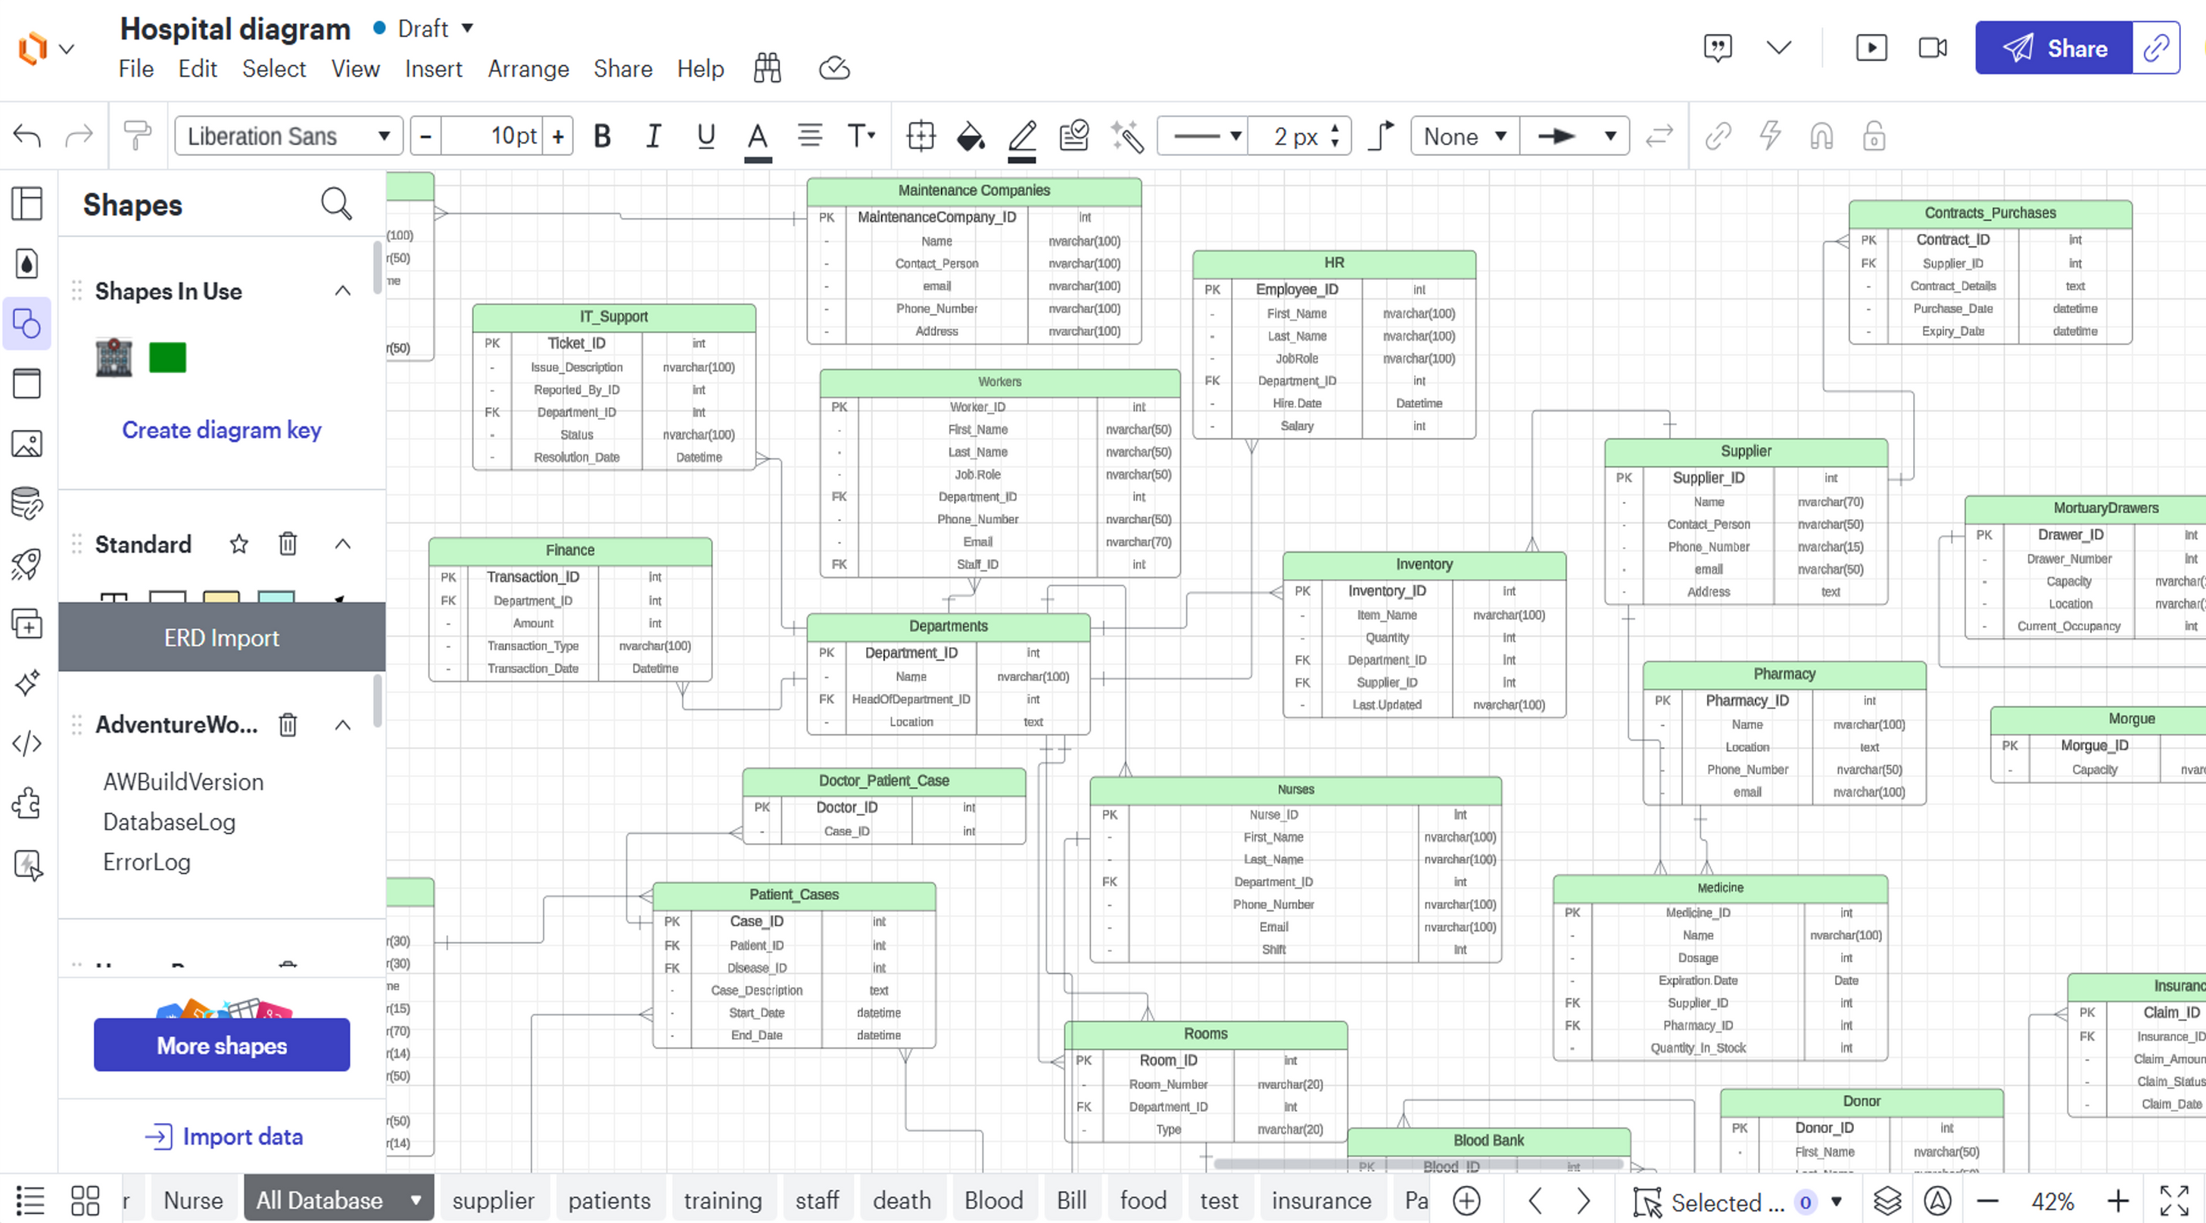
DIAGRAM

Slide 6
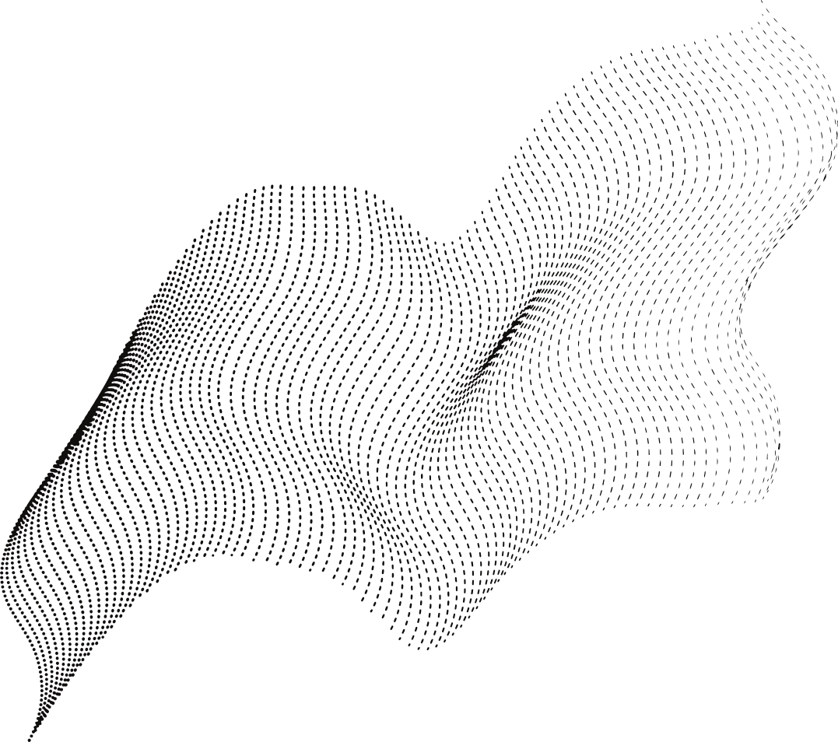
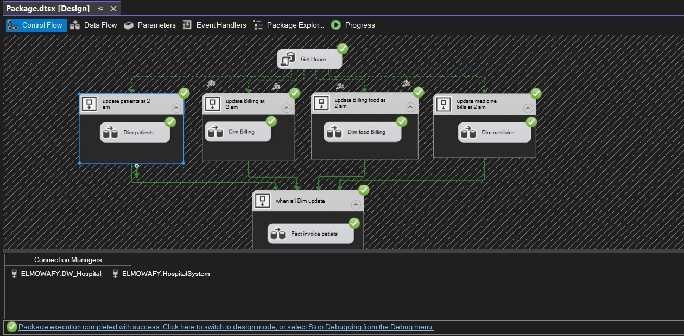
ETL

Slide 7
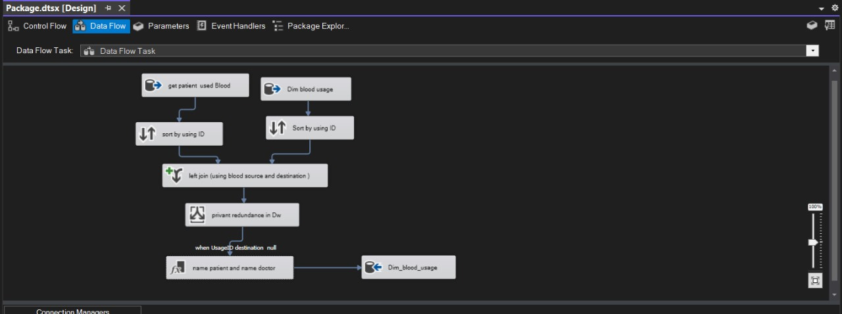
ETL

Slide 8

ML
MODEL
The primary goal of this project is to develop a CNN model that can accurately classify MRI images of brain tumors into four categories:
• No Tumor , Pituitary , Meningioma , Glioma
The dataset used for this project contains MRI images of brain tumors, labeled according to their respective categories. It is structured to facilitate the training and evaluation of the CNN model.

Slide 9

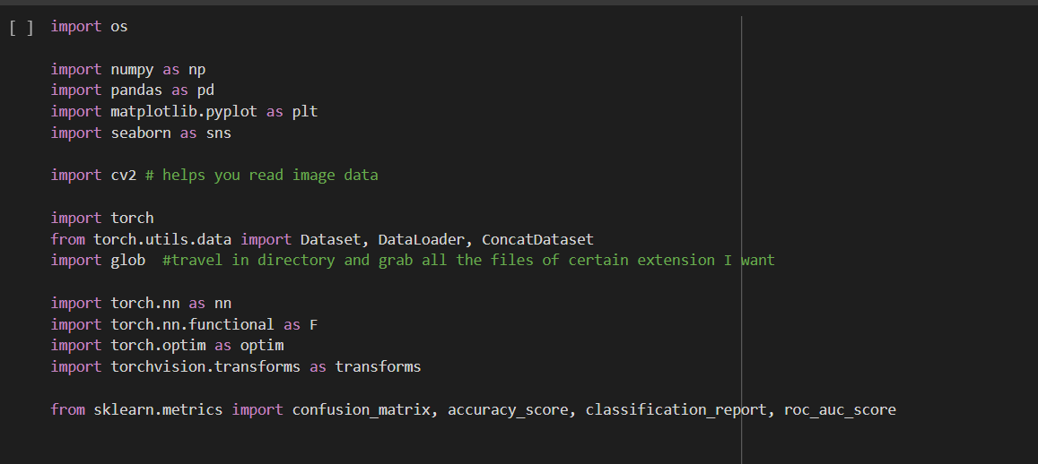
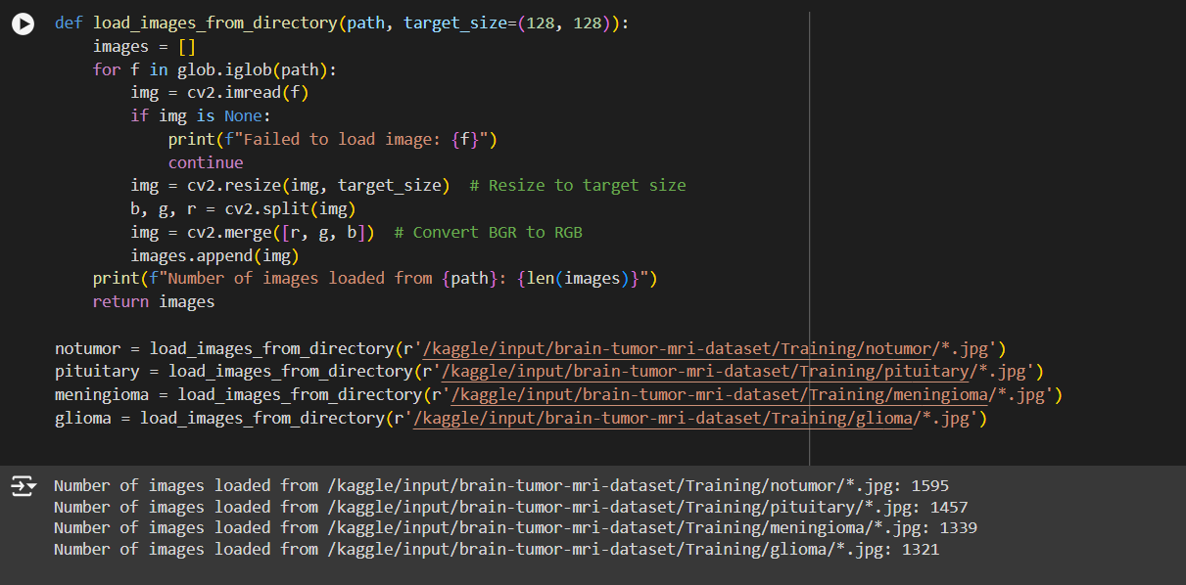

Slide 10
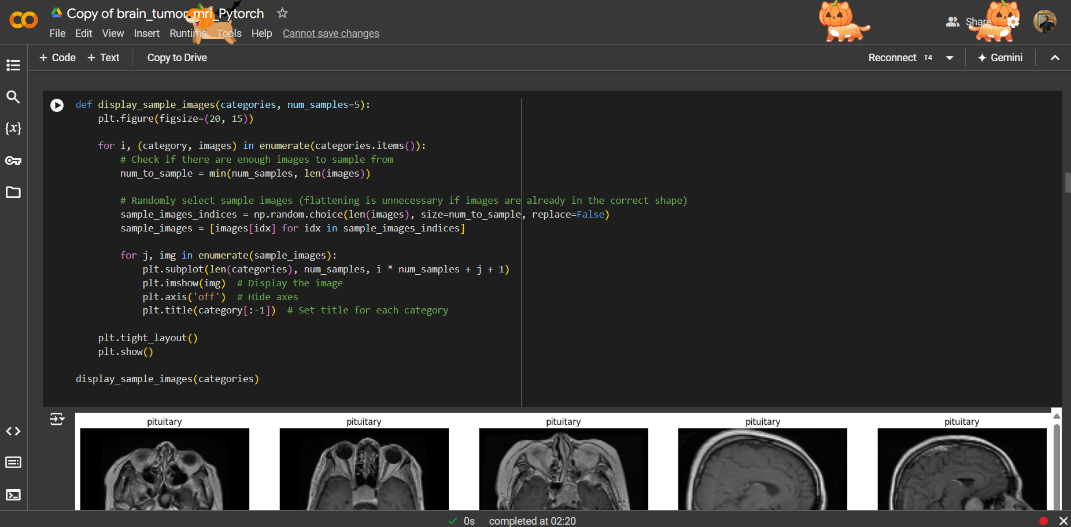

Slide 11
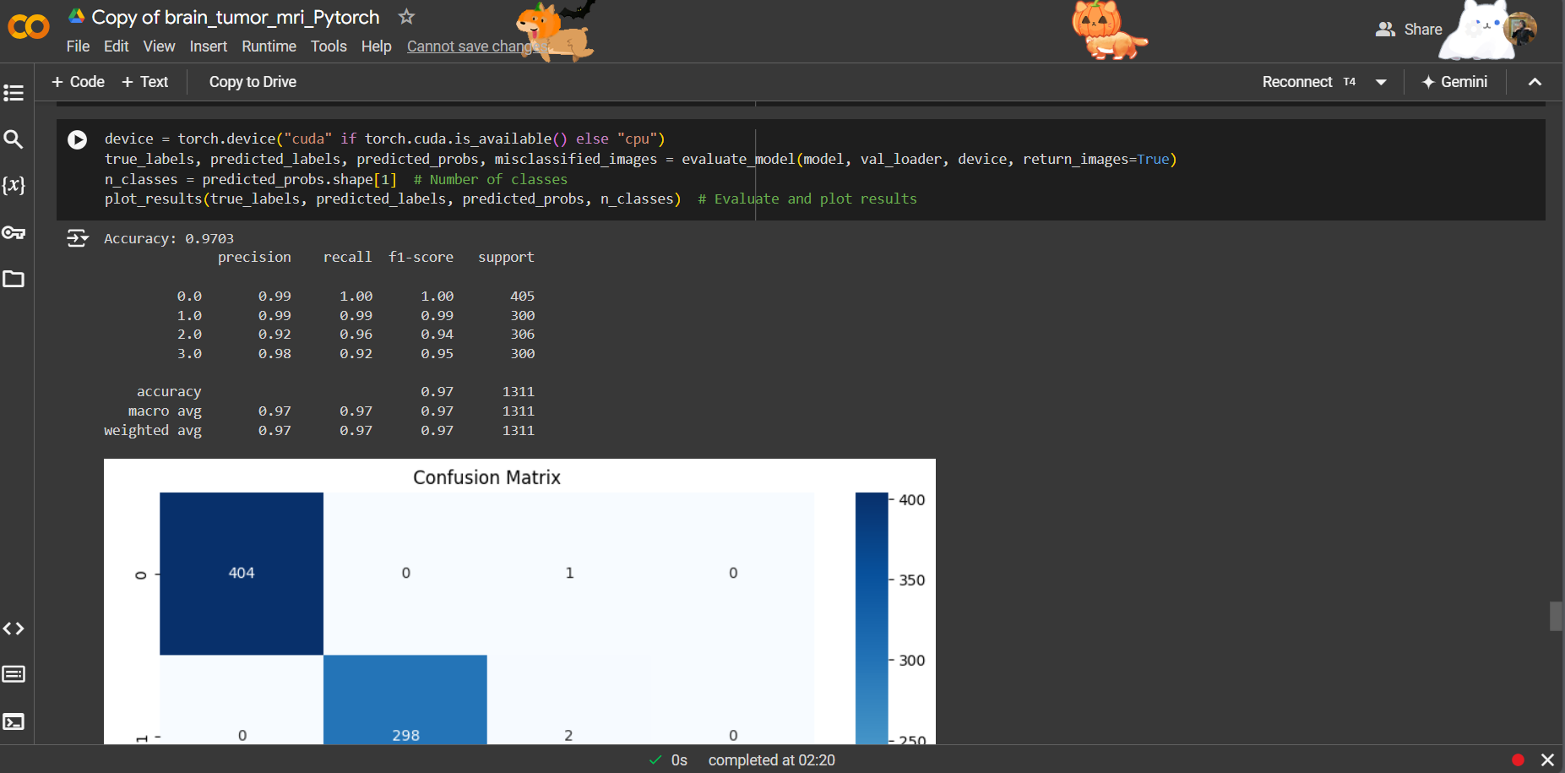

Slide 12
DATA ANALYSIS USING POWER BI

Slide 13
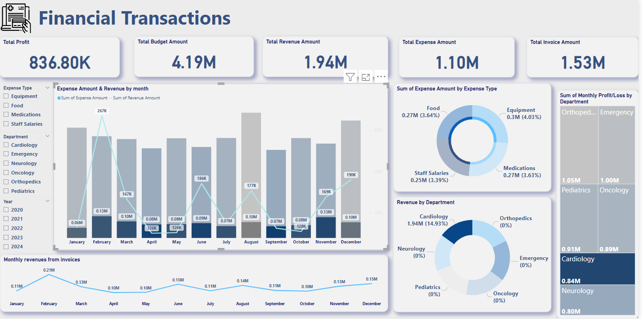

Slide 14
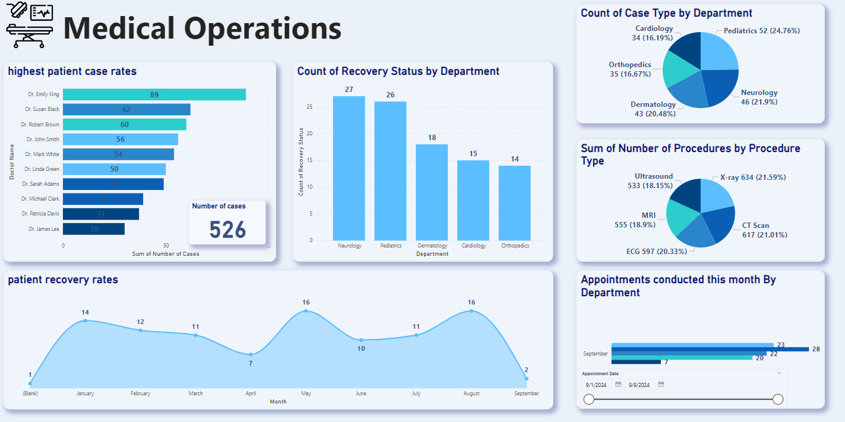

Slide 15
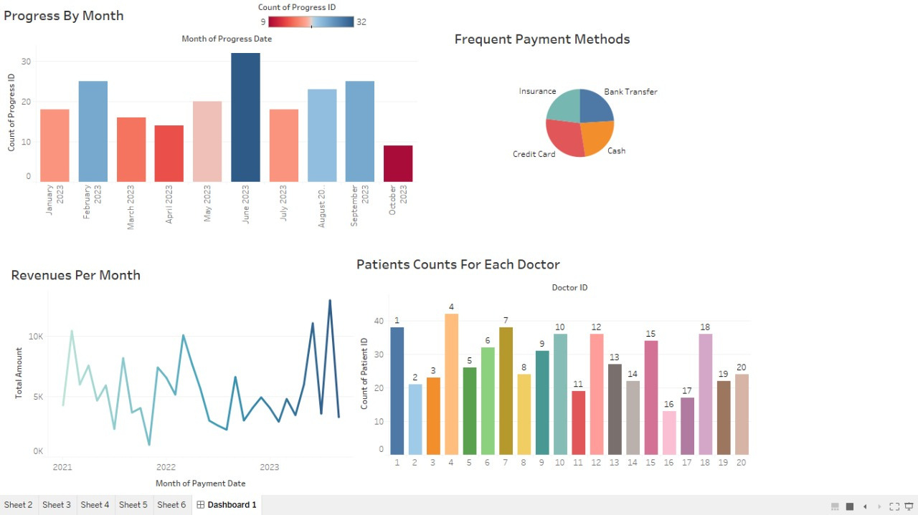

Slide 16


